Slide 1


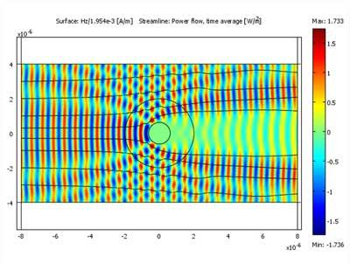
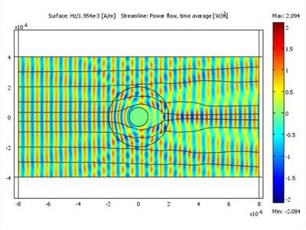
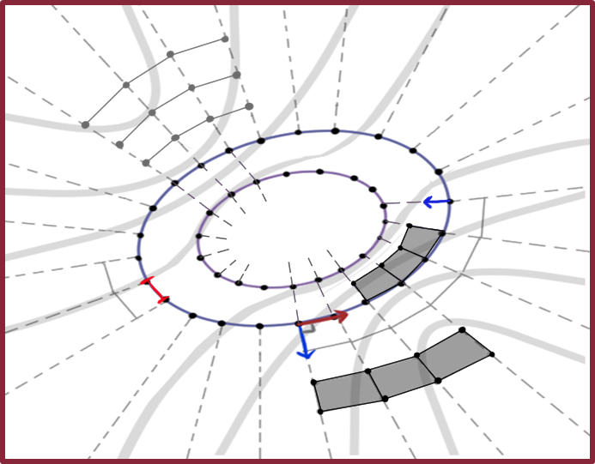
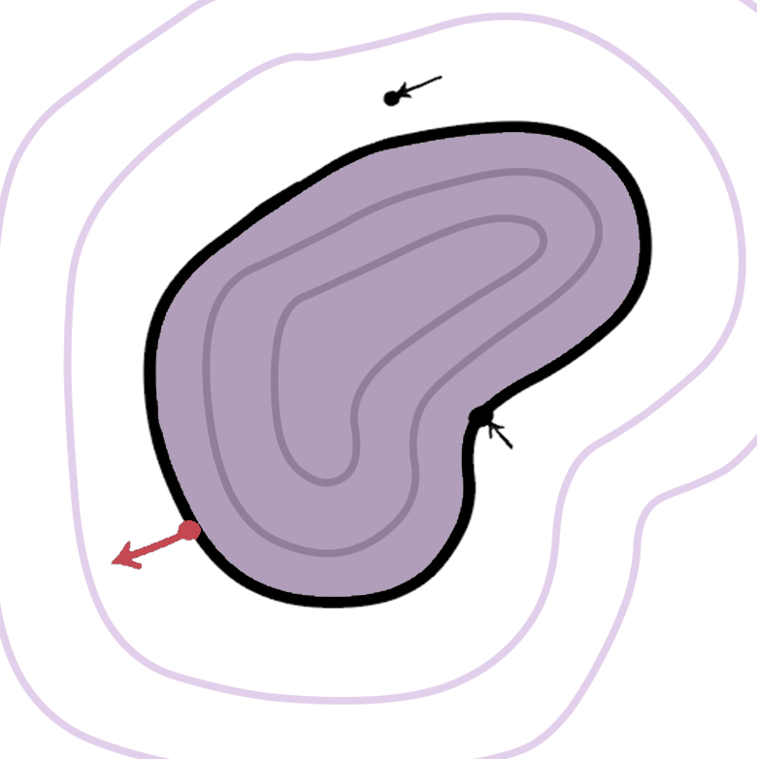
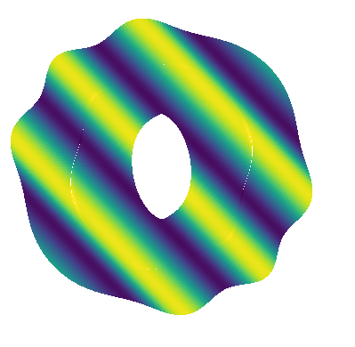
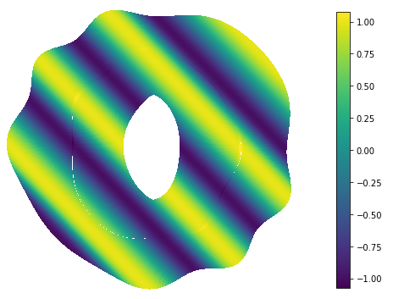
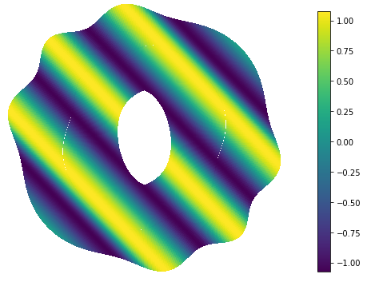
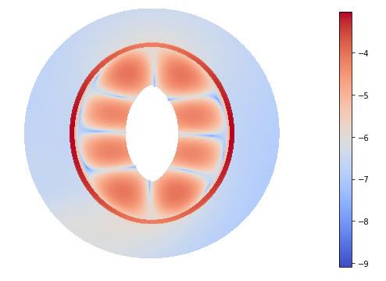

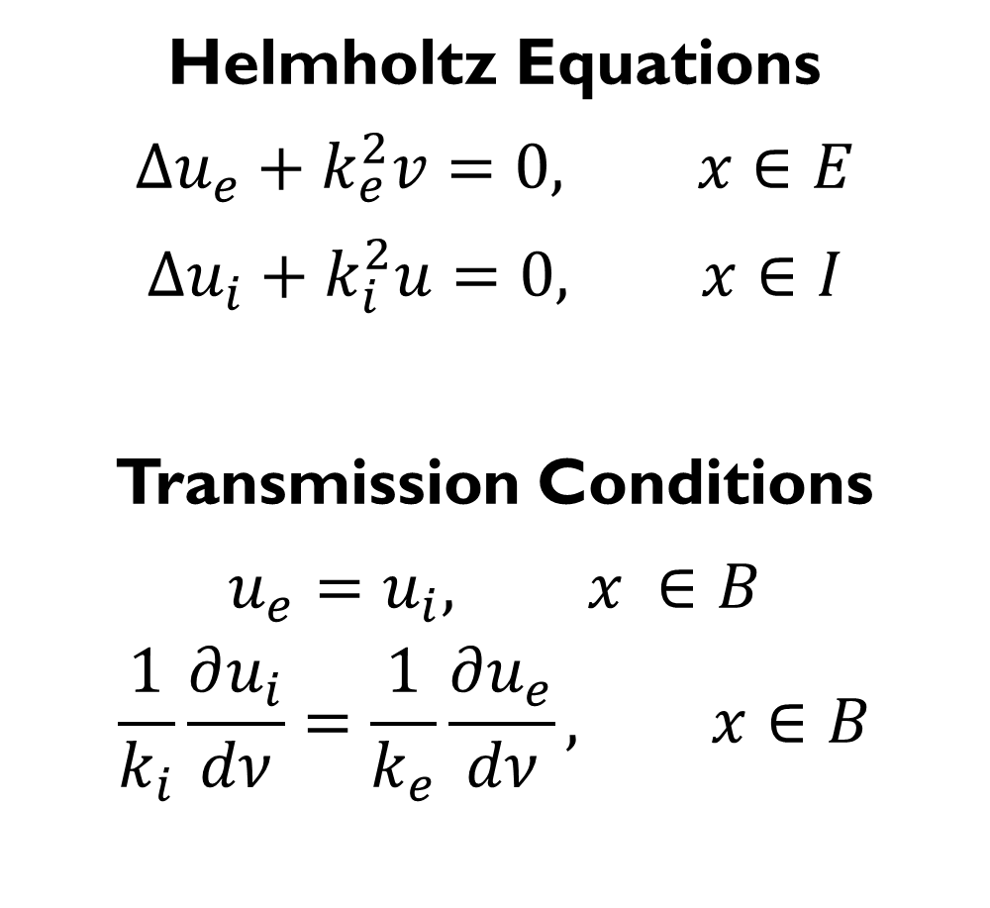
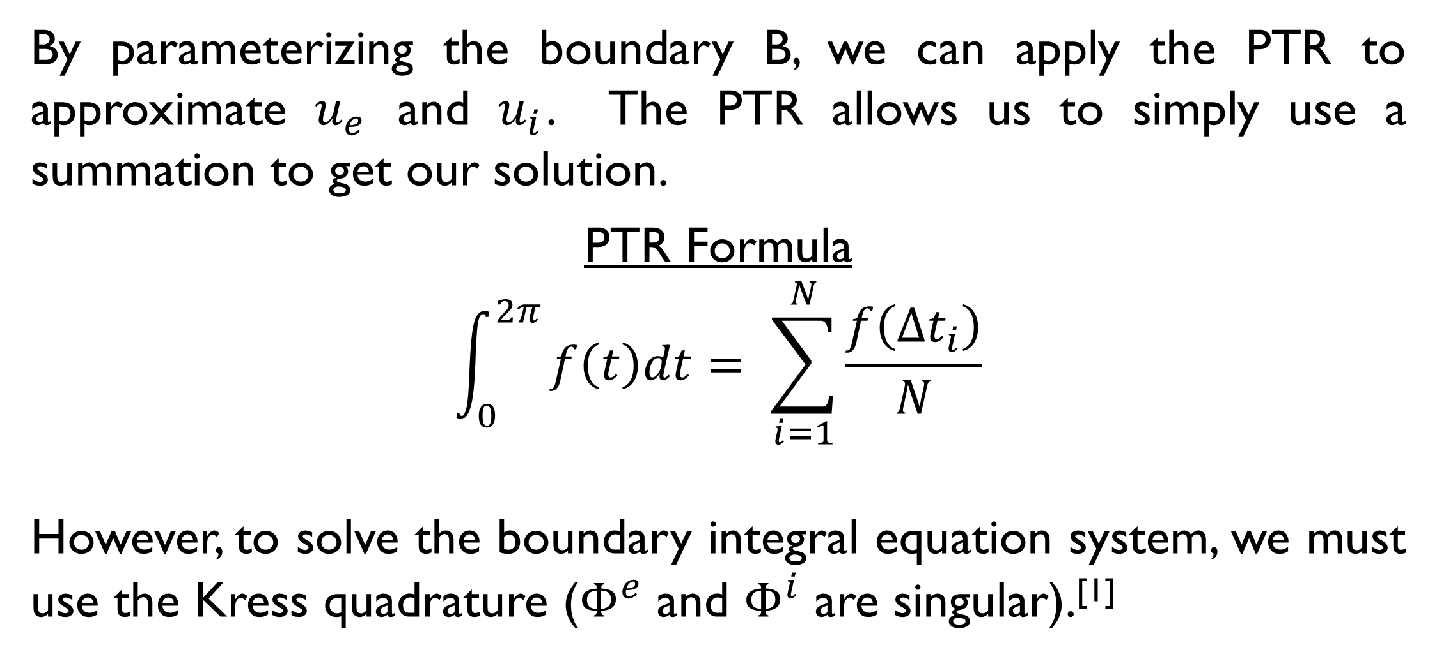

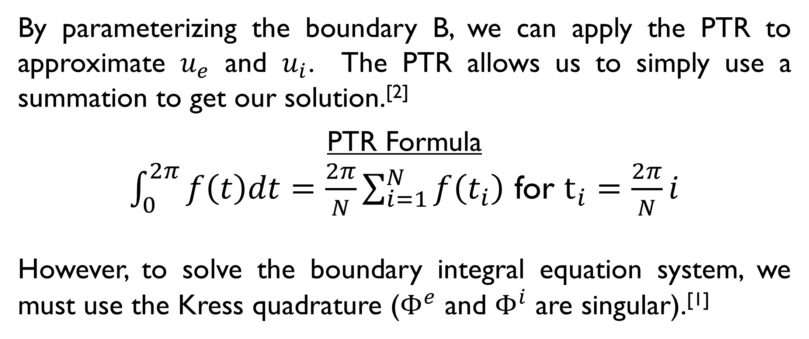



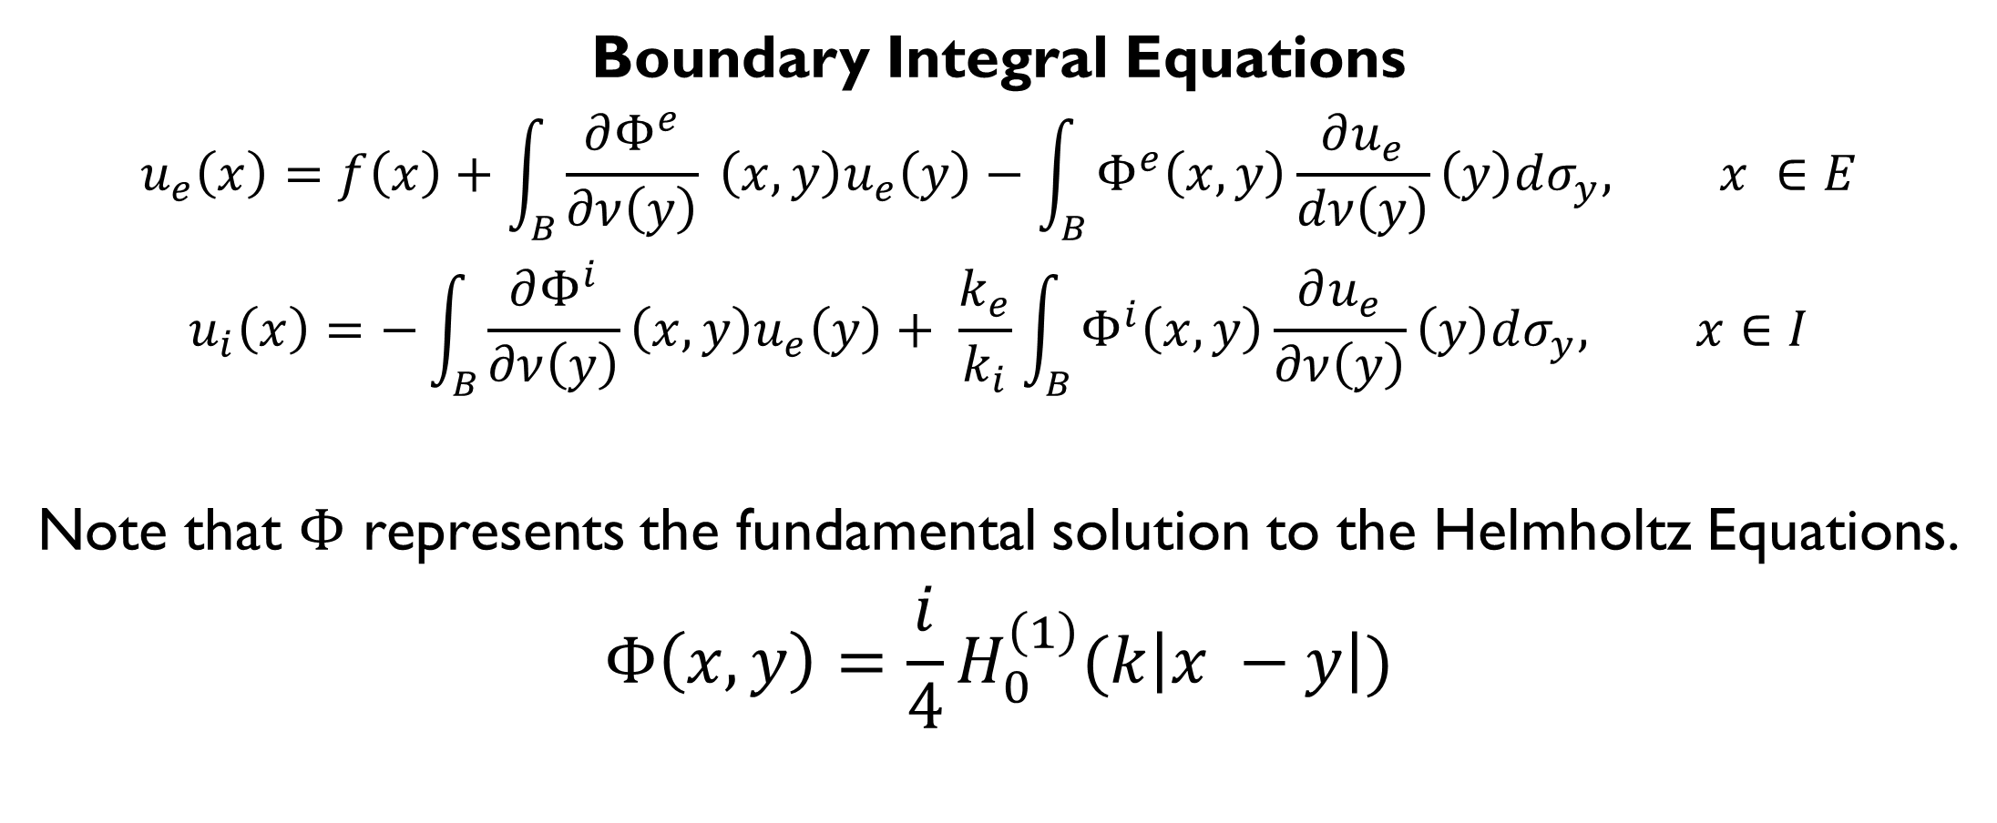




Cloaking using Periodic Trapezoid Rule Approximation of Boundary Integrals
E. A. Cortes, C. Carvalho, School of Natural Sciences, University of California, Merced
Introduction
Numerical Method
Transmission
Our goal is to simulate optical cloaking devices by calculating how light travels through defined boundaries. Optical cloaking refers to the act of making something invisible in some directions by preventing the scattering of light as it hits the boundary. Cloaking is often seen in science fiction, but also has real-world applications for radar and military science.
We use boundary integral equation methods to compute the solution in layered boundaries, and we implement in Python an approximation using the periodic trapezoid rule and the Kress Quadrature.^{[1]}
By parameterizing the boundary B, we can apply the PTR to approximate $u_{e}$ and $u_{i}$. The PTR allows us to simply use a summation to get our solution.^{[2]}
PTR Formula
$\int_{0}^{2π}{f\left(t\right)dt=\frac{2π}{N}\sum_{i=1}^{N}{f\left(t_{i}\right)}}$ for $t_{i}=\frac{2π}{N}i$
However, to solve the boundary integral equation system, we must use the Kress quadrature ($Φ^{e}$ and $Φ^{i}$ are singular).^{[1]}
Body-Fitted Grid
Figure 1. The scattering of light on an uncloaked object (left) versus that of a cloaked object (right).^{[4]}
$$t_{j}$$
PTR sums
Figure 2. The PTR is used to fill in a body-fitted grid originating from selected points on the boundary. The solution is computed in layers.
Transmission Problem
Validation
Conclusion
Solution $u_{e}$
$$x= <x_{1},x_{2}>$$
By parameterizing the boundary B, we can apply the PTR to approximate $u_{e}$ and $u_{i}$. The PTR allows us to simply use a summation to get our solution.
PTR Formula
$$\int_{0}^{2π}{f\left(t\right)dt= \sum_{i=1}^{N}{\frac{f\left(∆t_{i}\right)}{N}}}$$
However, to solve the boundary integral equation system, we must use the Kress quadrature ($Φ^{e}$ and $Φ^{i}$ are singular).^{[1]}
E
Helmholtz Equations
$$∆u_{e}+k_{e}^{2}v=0, x∈E$$
$$∆u_{i}+k_{i}^{2}u=0, x∈I$$
Transmission Conditions
$$u_{e}=u_{i}, x ∈B$$
$$\frac{1}{k_{i}}\frac{∂u_{i}}{dν}=\frac{1}{k_{e}}\frac{∂u_{e}}{dν}, x∈B$$
I
B
Data $f$
Solution $u_{i}$
Figure 3a. The plot of the real part (left) and the imaginary part (right) of the PTR solution for an ellipse-shaped boundary.
Wave number $k_{i}$
$$y= <y_{1},y_{2}>$$
$$ν$$
Wave number $k_{e}$
REFERENCES
[1] R. Kress, Boundary Integral Equations in Time-Harmonic Acoustic Scattering.
[2] C. Carvalho, S. Khatri, and A.D. Kim, Asymptotic analysis for close evaluation of layer potentials, submitted.
[3] Boundary Cloaking GitHub Repository, code available: https://github.com/eangelcortes/boundary_cloaking.
[4] V. Shalaev, Illustration of a theoretical cloaking device.
Boundary Integral Equations
$$u_{e}\left(x\right)=f\left(x\right)+\int_{B}{\frac{∂Φ^{e}}{∂ν\left(y\right)}} \left(x, y\right)u_{e}\left(y\right)−\int_{B}{Φ^{e}\left(x,y\right)\frac{∂u_{e}}{dν\left(y\right)}\left(y\right)dσ_{y}, x ∈E}$$
$$u_{i}\left(x\right)=−\int_{B}{\frac{∂Φ^{i}}{∂ν\left(y\right)}\left(x, y\right)u_{e}\left(y\right)+ \frac{k_{e}}{k_{i}}\int_{B}{Φ^{i}\left(x,y\right)\frac{∂u_{e}}{∂ν\left(y\right)}\left(y\right)dσ_{y}, x∈I}}$$
Note that $Φ$ represents the fundamental solution to the Helmholtz Equations.
$$Φ\left(x,y\right)=\frac{i}{4}H_{0}^{\left(1\right)}(k\left|x −y\right|)$$
Figure 3b. The plot of the real part (left) and the imaginary part (right) of the exact solution for a plane wave acting on an ellipse boundary.
Figure 4. The log error plot between the surfaces shown in Figure 3a and 3b. Because our method is nearly singular as our points approach the boundary, there is a significant increase in error around the defined ellipse.

